Slide 1
Data Structures : Linked List
Power Skills (Behavioral) - Foundation-Session 8
By: Sneha Garg (Emp Id: 30010000)
System C with Linux System Programming Aug22 Batch CHE

Slide 2
Agenda
Introduction
Structure of Linked List
Types of Linked List
Singly Linked List
Doubly Linked List
Circular Linked List
Conclusion

Slide 3
What is Linked List?
A linked list is a linear data structure.
Data structures are ways to organize and store data in a computer so that it can be used efficiently.
Linked list contains nodes in which data and address to next node is stored.
The pointer pointing the address to next node is generally named as next.
Operations like insertion, deletion can be done in linked list.

Slide 4
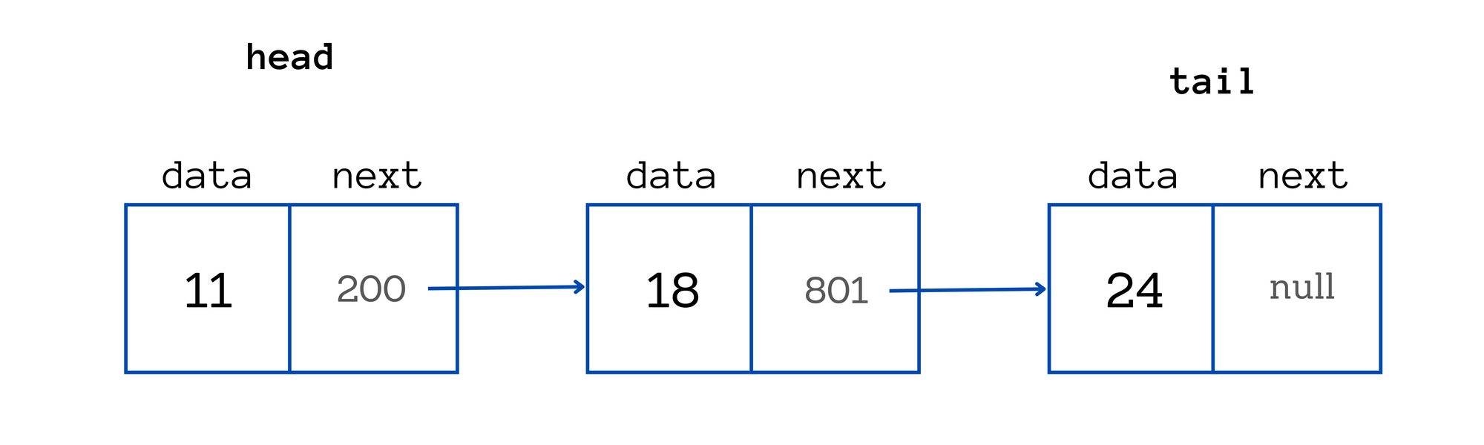
Structure of Linked List
struct Node {
int data; // Data part
struct Node* next; // Pointer to the next node
};

Slide 5
Types of Linked List
There are mainly 3 types of linked list:
Singly Linked List
Doubly Linked List
Circular linked list

Slide 6
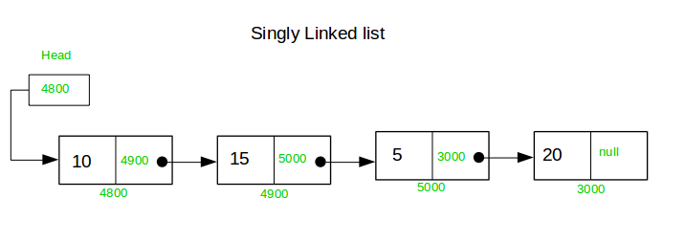
Singly Linked List
Each node has only one linked part.
Each link part contains the address of the next node in the list.
Link part of the last node contains NULL value which signifies the end of the linked list.

Slide 7
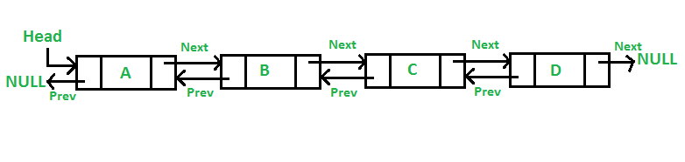
Doubly Linked List
Each node has three parts, in which one part contains data and the other two have address.
One link part points to previous node and the other points to next node.
Two pointers : head and tail Head points to the first node and tail points to the second node in the linked list.

Slide 8
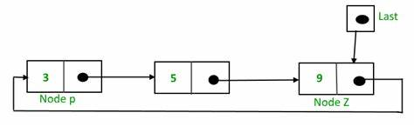
Circular Linked List
Each node points to the next node, and the last node points back to the first node, forming a circle.
There are no NULL references in a circular linked list.
Can be singly circular linked (one direction) or doubly circular linked (both directions).

Slide 9
What have we learnt so far?
Linked list is a linear data structure consisting of nodes.
Structure of linked list (i.e. node) contain data and address to the next node.
Singly Linked List: Each node points to the next node; traversal is unidirectional.
Doubly Linked List: Nodes point to both the next and previous nodes; allows bidirectional traversal.
Circular Linked List: The last node points back to the first node, enabling continuous traversal without a NULL reference.

Slide 10
Thank you :)

